Slide 1

Serverless Content Management System with AWS App Runner
Sreeja Boddula (2210030248)
Under the esteemed guidance of
Ms. P. Sree Lakshmi
Assistant Professor,
Department of Computer Science and Engineering

Slide 2
Project Overview
Problem: Traditional content management systems require backend server maintenance. Objective: To create a serverless content management system that automates deployment and scaling using AWS AppRunner. Relevance: Reduces infrastructure management, ideal for dynamic portfolio or blogging platforms.

Slide 3
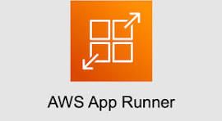
Services Used
AWS App Runner: Automatically deploys and scales
applications from source code (GitHub).
- AWS IAM: Manages access control. - AWS CloudWatch: Monitors performance and logs. Other Tools: - GitHub: Version control and source repository.

Slide 4

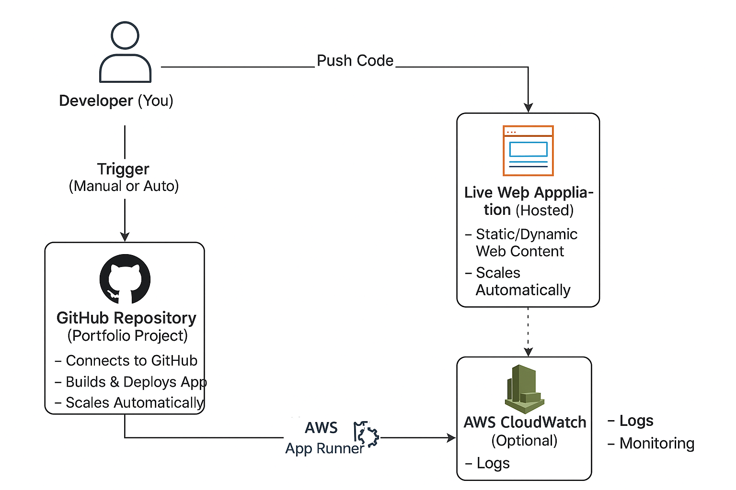
Flow Diagram
GitHub Repo ➝ AWS App Runner ➝ Live Web App
Tools Used: - AWS Console for setup - GitHub Actions (optional CI/CD integration) - No backend servers (serverless)

Slide 5
Implementation Process
1. Created a portfolio project and pushed it to GitHub. 2. Linked GitHub repo with AWS App Runner. 3. Configured App Runner to auto-deploy on changes. 4. Deployed app using AWS Console.

Slide 6
Code Snippets
const express = require('express');
const path = require('path');
const app = express();
const port = process.env.PORT || 3030;
let ownerIP = null;
const guestAccessMap = {};
app.set('trust proxy', true); // Trust proxy headers to get real IP
app.get('/', (req, res) => {
const userIP = req.ip;
const now = Date.now();
// First visitor becomes the owner
if (!ownerIP) {
ownerIP = userIP;
console.log(`👑 Registered owner IP: ${ownerIP}`);
}
// If user is owner, allow full access
if (userIP === ownerIP) {
return res.sendFile(path.join(__dirname, 'public', 'index1.html'));
}
// Guest access control (2 seconds only)
if (!guestAccessMap[userIP]) {
guestAccessMap[userIP] = now;
}
const elapsed = now - guestAccessMap[userIP];
if (elapsed > 2000) {
return res.status(403).send('⏳ Guest link has expired for you.');
}
res.sendFile(path.join(__dirname, 'public', 'index1.html'));
});
app.get('/health', (req, res) => res.status(200).send('OK'));
app.listen(port, () => {
console.log(`🚀 App listening on port ${port}`);
});

Slide 7

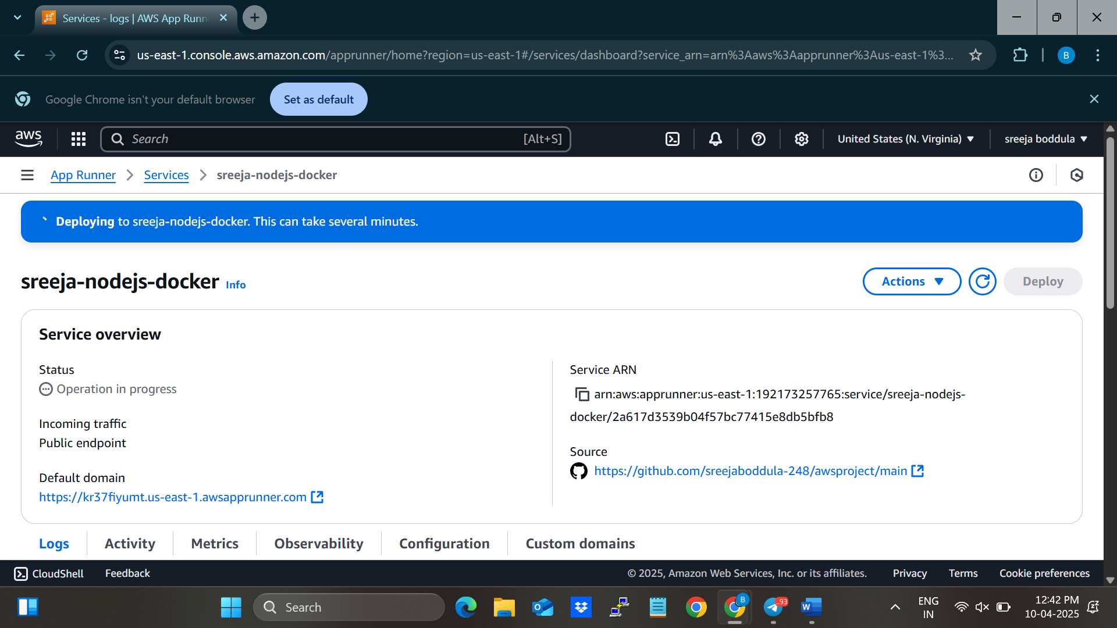



Screenshot

Slide 8
Key Features and Functionality
- Automatic deployment from GitHub - Real-time content updates - Serverless architecture - Simple UI with React (or HTML/CSS if static)

Slide 9
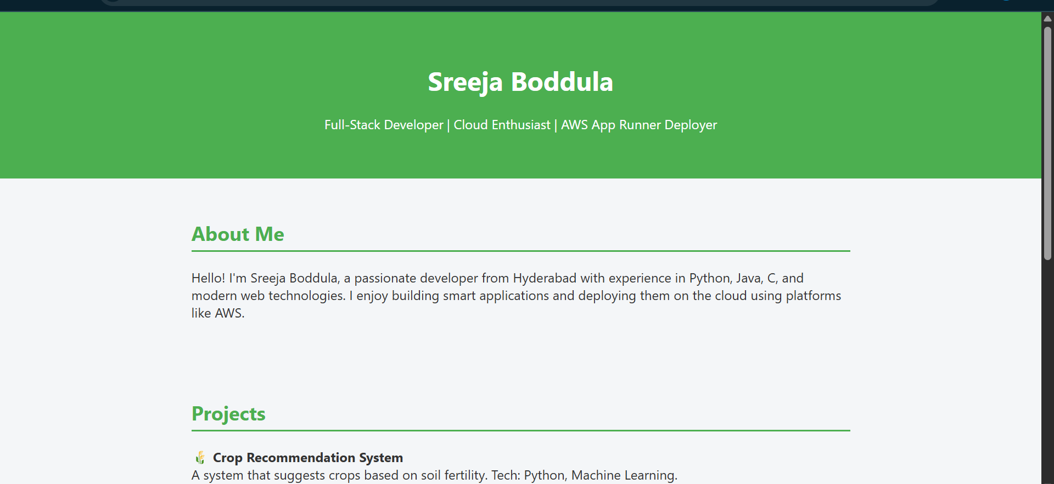
Results and Outputs
Deployed live application URL - CloudWatch logs show uptime and successful deploys - Auto-scaling observed with traffic simulation

Slide 10
Challenges and Solutions
- Issue: App Runner failed on first build Solution: Checked build logs, updated build command - Issue: IAM permission errors Solution: Assigned correct roles with least privilege

Slide 11
Learnings & Takeaways
- Gained hands-on with AWS App Runner, IAM, and GitHub integrations - Learned CI/CD basics - Improved debugging and deployment skills - Earned AWS Fundamentals Badge

Slide 12
Future Scope
- Add authentication and role-based content editing - Use DynamoDB for structured content storage - Optimize costs by integrating with CloudFront - Real-time analytics with AWS Pinpoint

Slide 13
References
- GitHub Repository: https://github.com/sreejaboddula-248/awsproject - AWS Documentation - Project walkthroughs and tutorials

Slide 14
THANK YOU

